Slide 1
Making Better Technical Oral Presentations
David E. Rosenberg
Bethany Neilson
Environmental Engineering Seminar
February 20, 2014

Slide 2
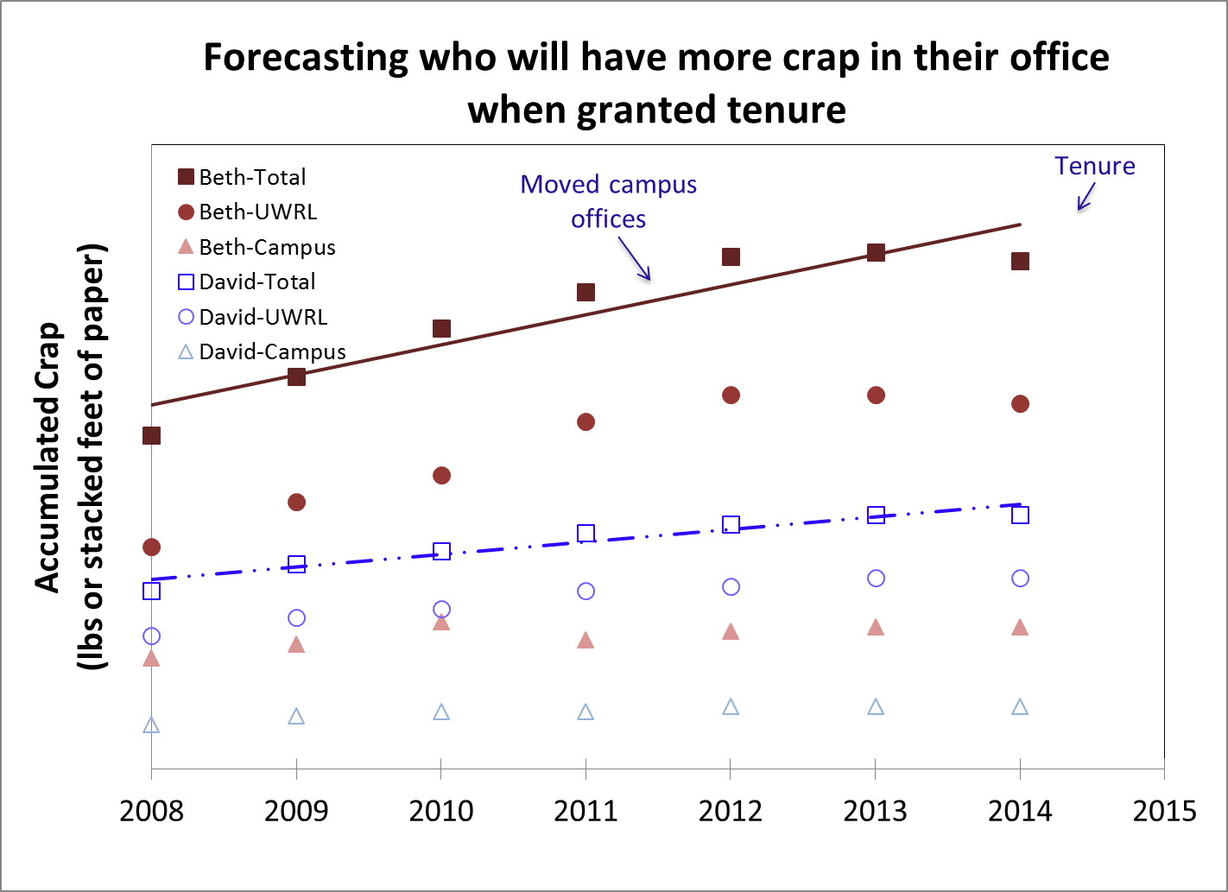

Slide 3
First Draft for TEDxUSU
Optimal

Slide 4
First Draft for TEDxUSU
Optimal
Near-Optimal (removal cost ≤ 110% of optimal)

Slide 5
Final Version

